Slide 1
Unicorn E-commerce Platform
Sales Report

Slide 2
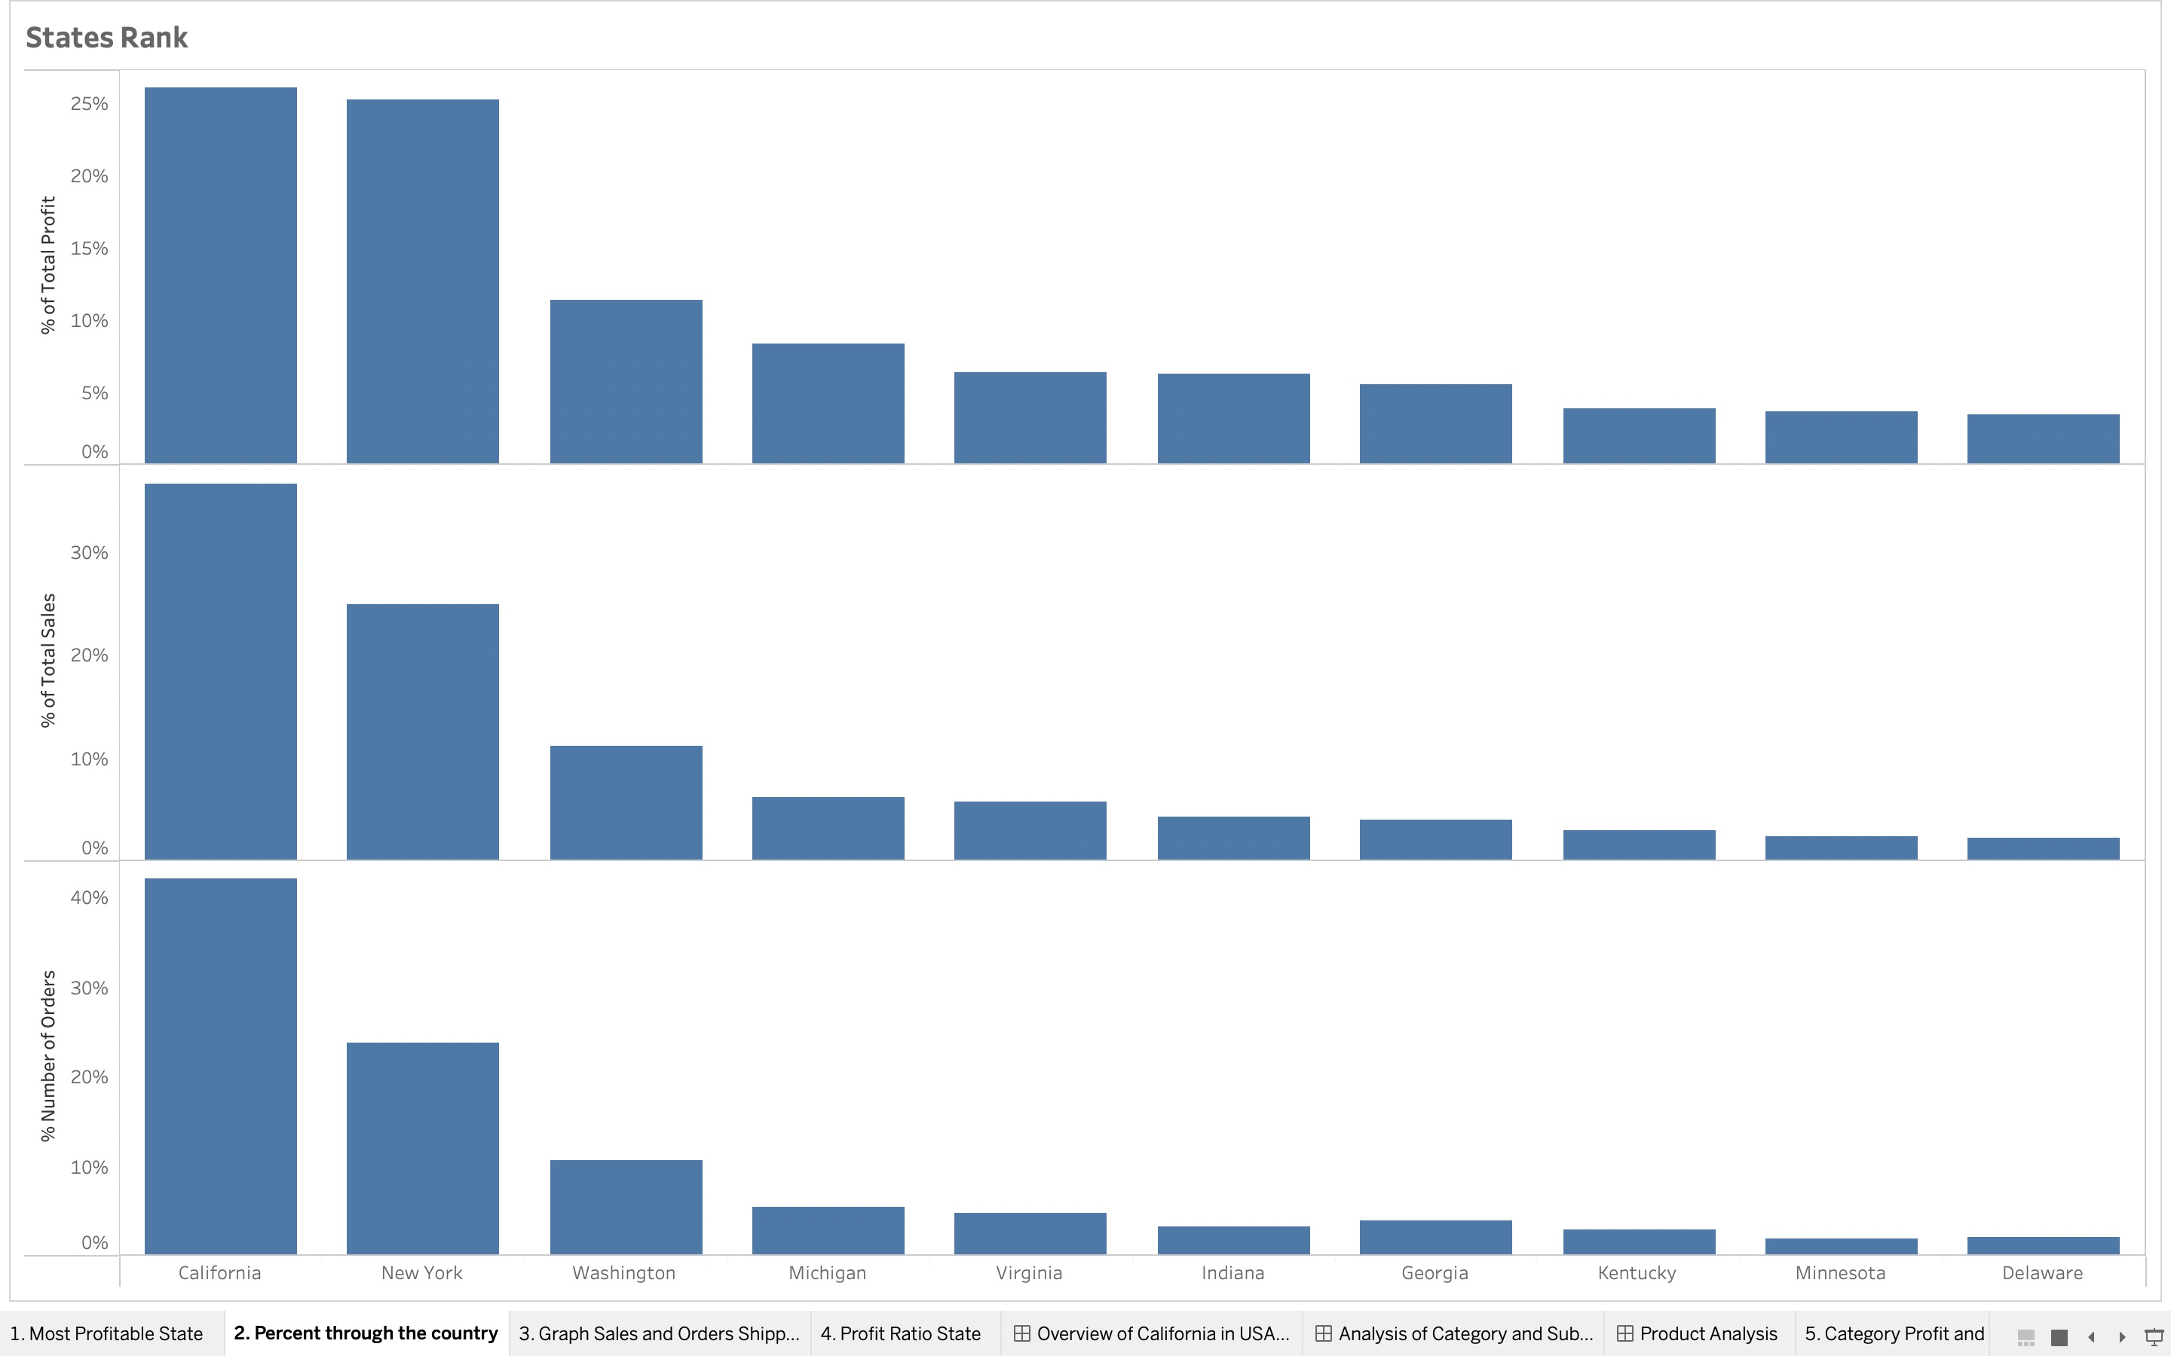
California ranks first

Slide 3
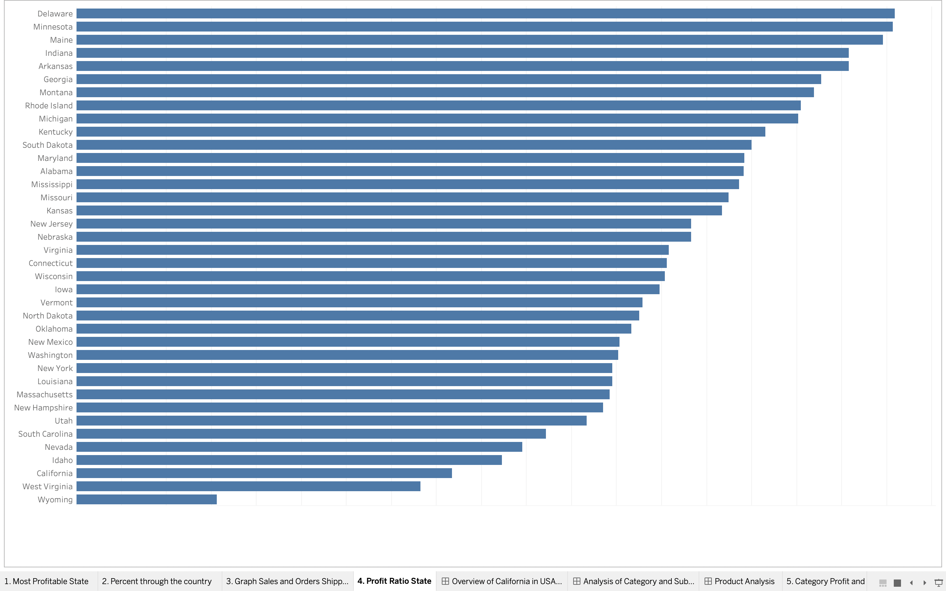
profit margin

Slide 4
California’s position
California ranks first in Sales and profits as largest State. However, it lags behind other states in profitability.

Slide 5
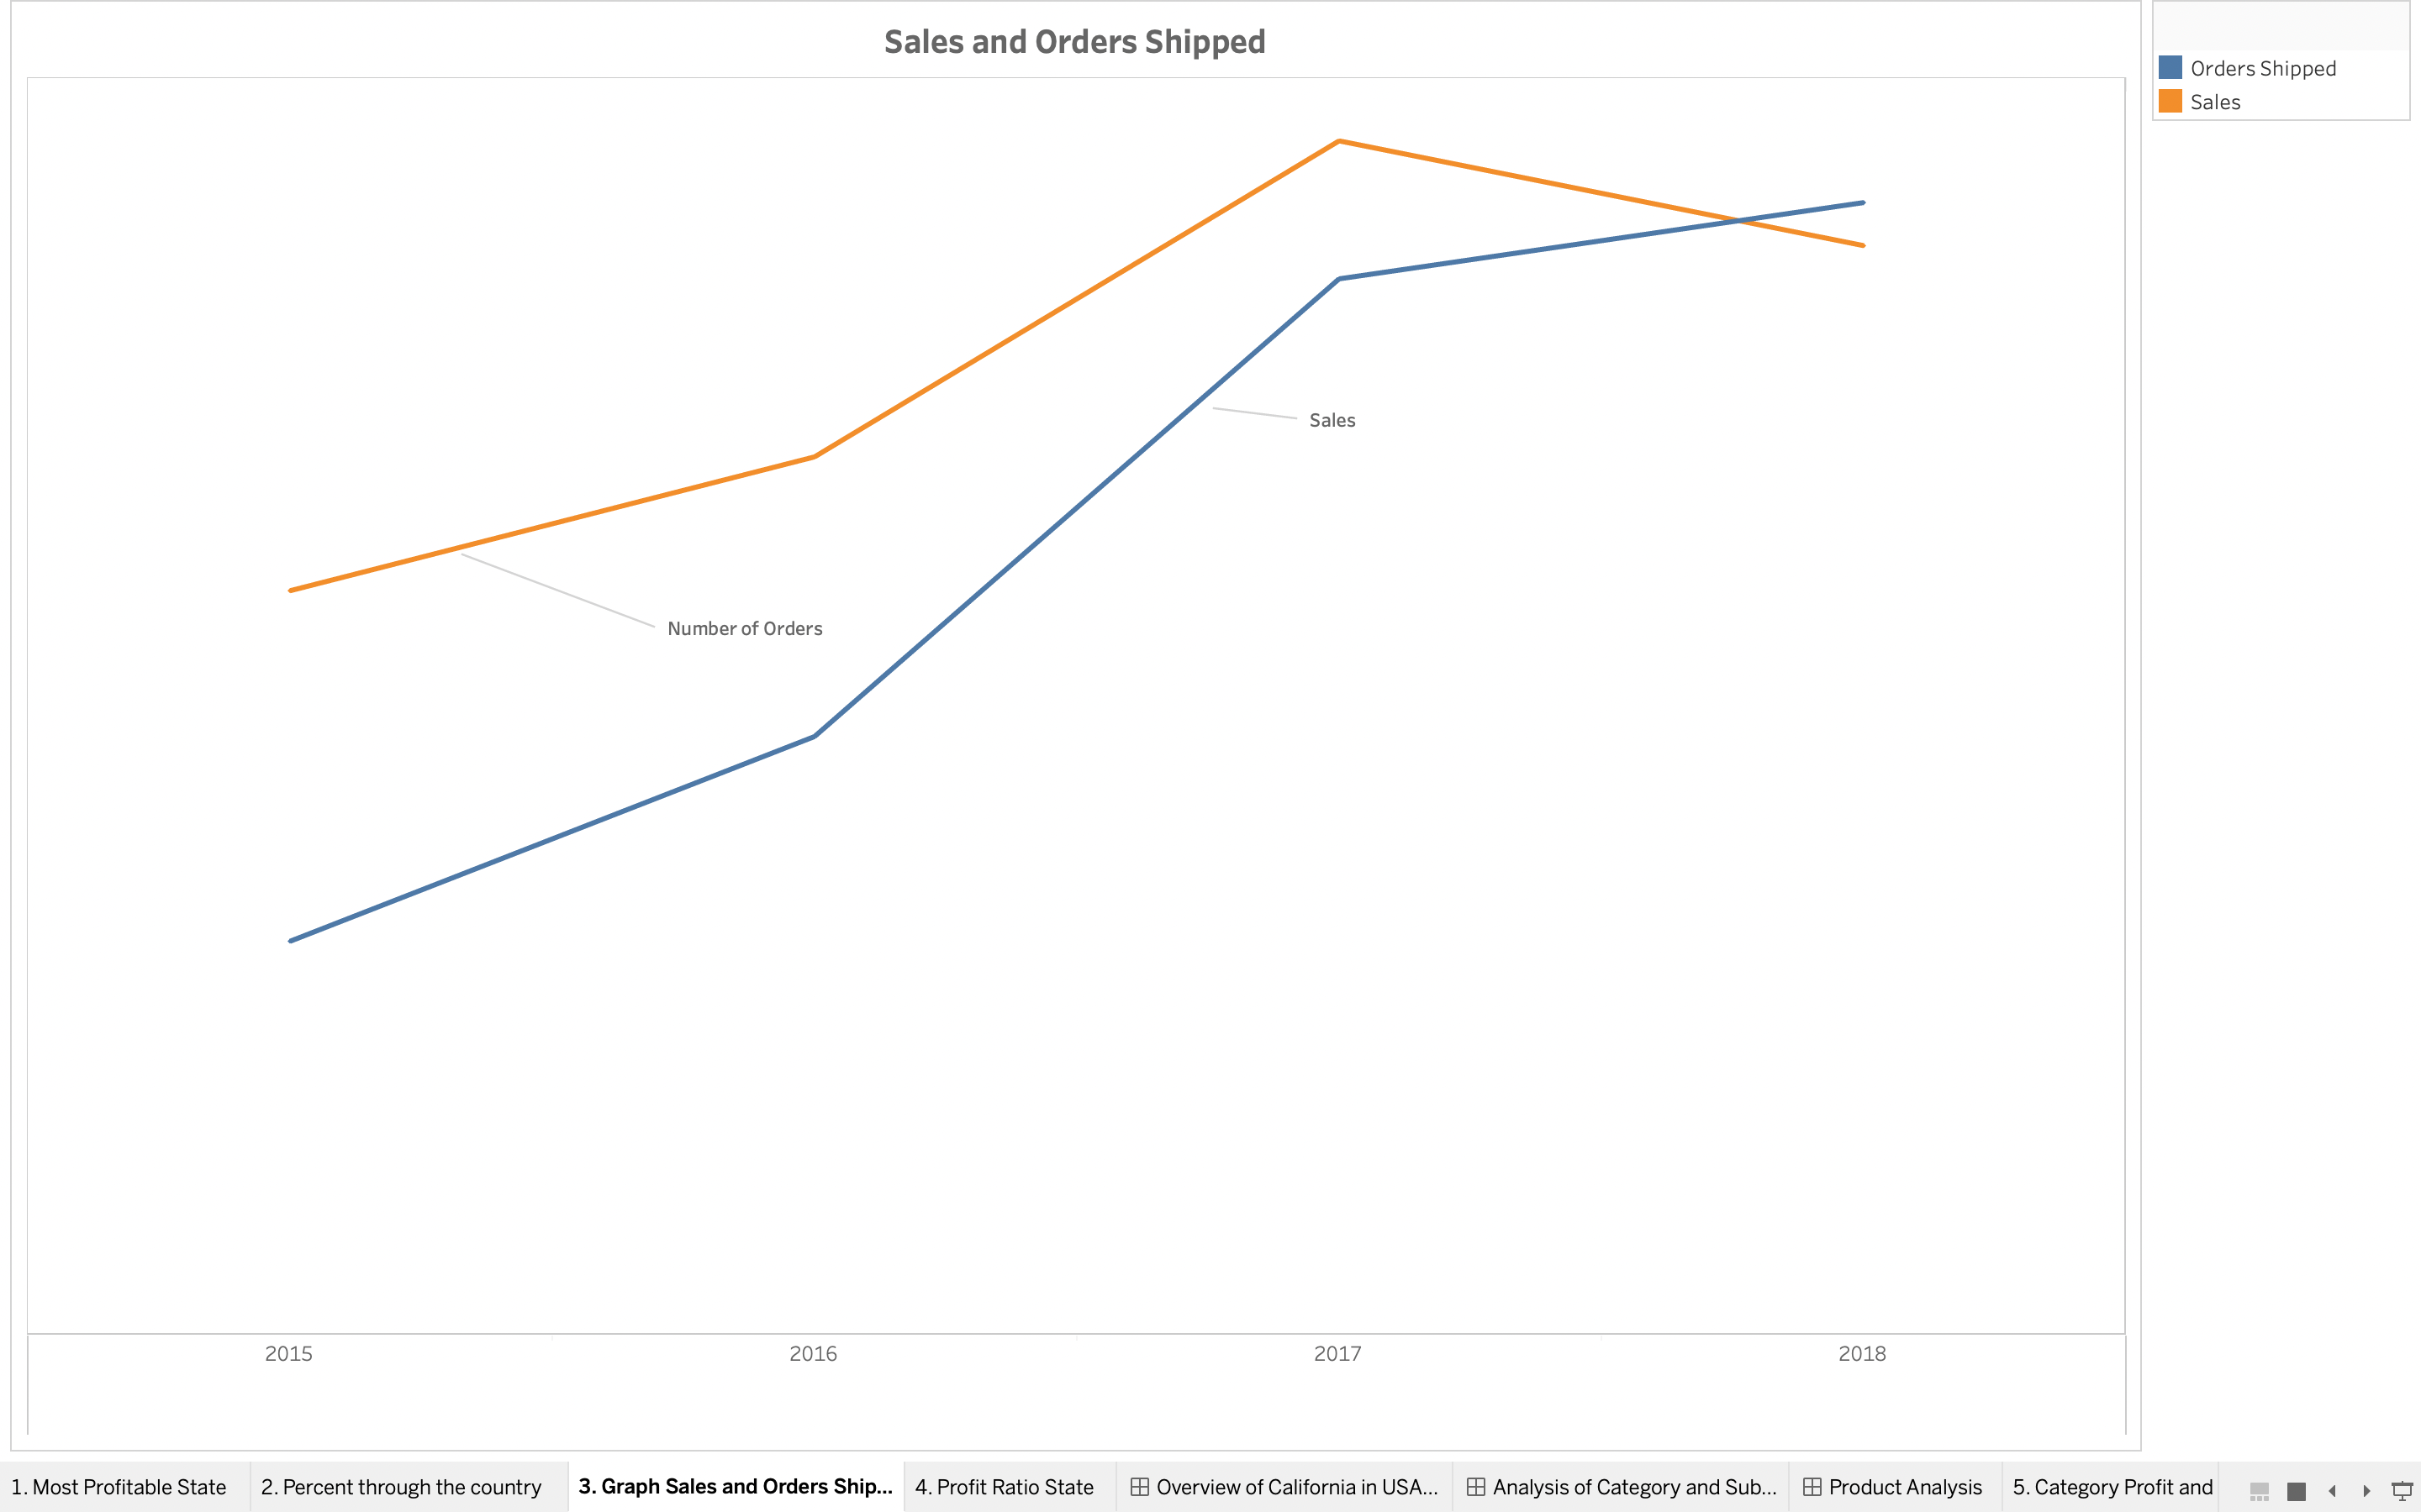
The Sales and number of orders shipped over four years
 | 2015 | 2016 | 2017 | 2018
Sales | $86,619.00 | $102,192.00 | $138,953.00 | $129,967.00
Change ($) |  | $15,573.00 | $36,761.00 | -$8,986.00
Change (%) |  | 18% | 36% | -6%
Orders Shipped | 398 | 449 | 563 | 591
Change (Count) |  | 51 | 114 | 28
Change (%) |  | 13% | 25% | 5%
Sales per Order | $217.64 | $227.60 | $246.81 | $219.91
Change ($) |  | $9.96 | $19.21 | -$26.90
Change (%) |  | 5% | 8% | -11%

Slide 6
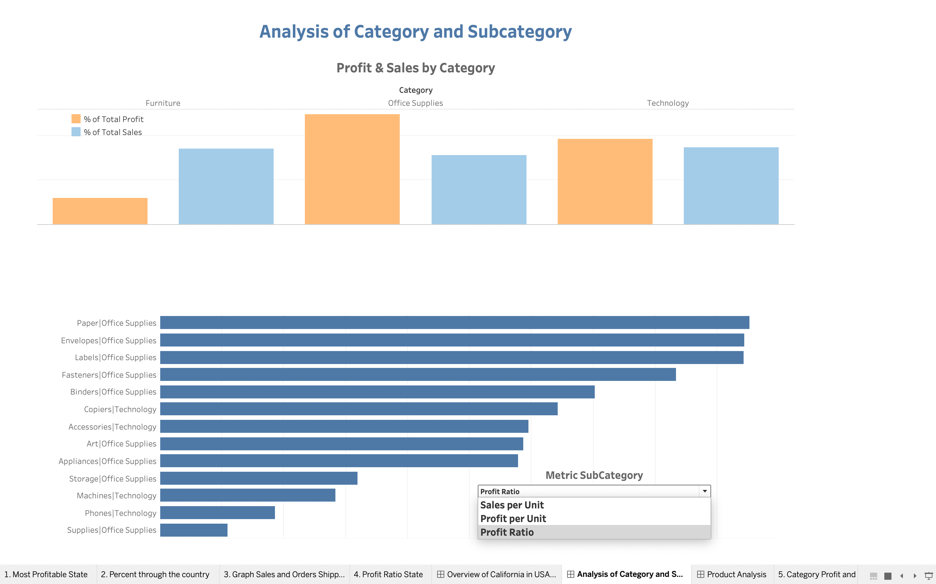

Slide 7
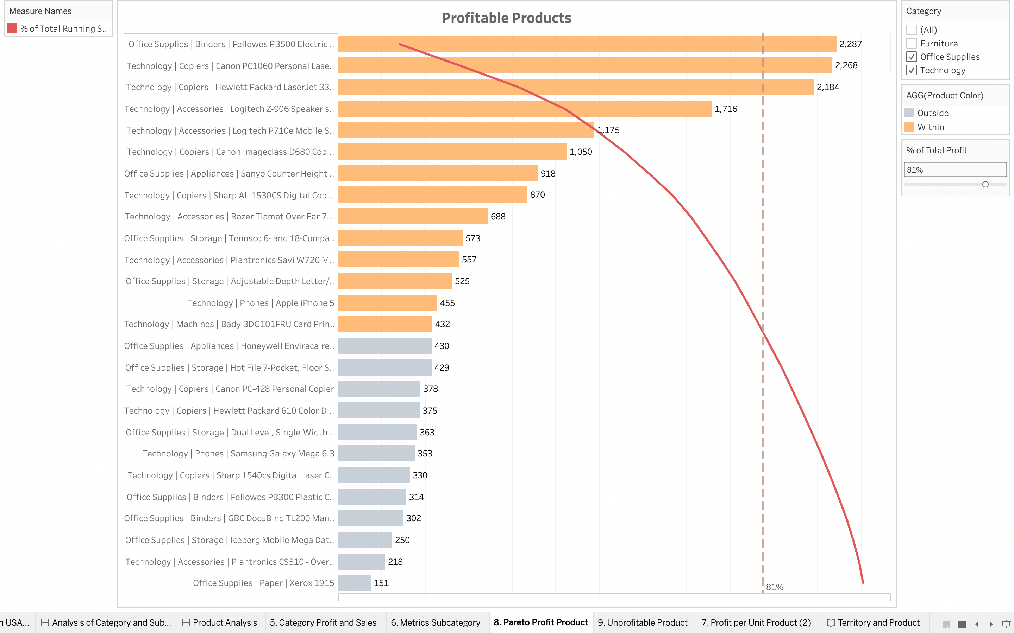
Product pareto analysis

Slide 8
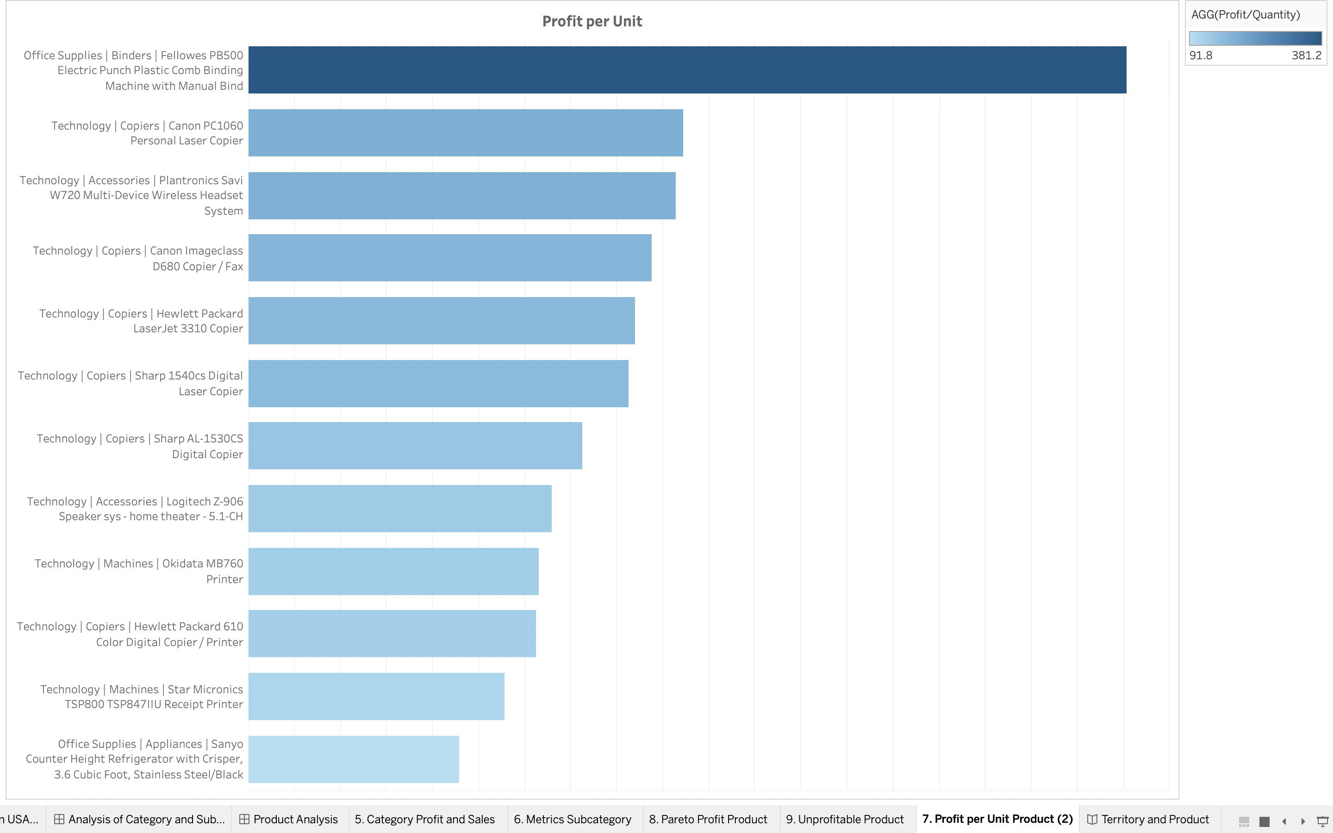
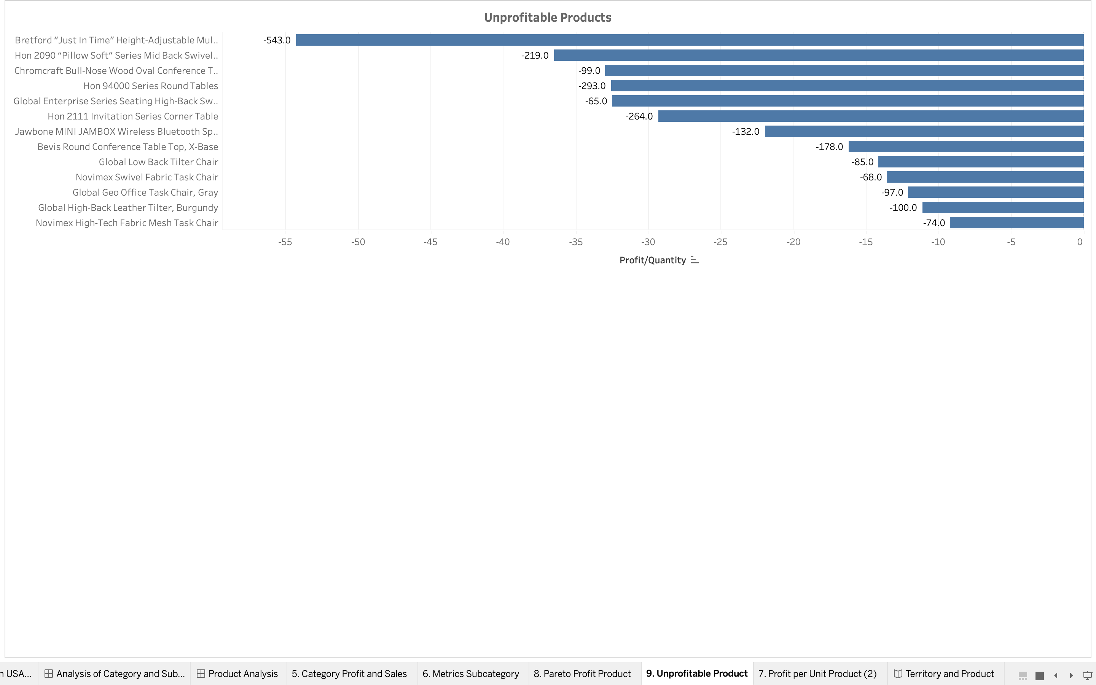
Profitable and unprofitable products

